Slide 1
CHEM DSE 202
Group 15
NITROGEN FAMILY

Slide 2
Topics covered
Hydrides of nitrogen
Hydrides of Phosphorus
Halides of Nitrogen
Halides of Phosphorus

Slide 3
Hydrides of Nitrogen
The most common hydrides formed by all the elements of group 15 are MH3 (Trihydrides)
Ammonia NH3
Phosphine PH3
Arsine AsH3
Stibine SbH3
Bismuthine BiH3
Nitrogen also forms other hydrides like N2H4 (Hydrazine),N2H2 (Diamide) and N3H (Hydrazoic acid)

Slide 4
NH3 AMMONIA
It is the only gas that is basic in nature and its solution in water is called aqueous ammonia
Liquid NH3 undergoes self ionisation like water and is used as a solvent NH3 + NH3 NH4⁺ + NH2_
When heated at 800 C ,in presence of Pt ,it gives mixture of oxides
⁴NH3 + 6O2 2NO2 + 2NO + H2O
With Carbon dioxide under pressure it gives urea
2NH3 + CO2 NH2CONH2 + H2O
Why is liq NH3 A good non aqueous solvent?

Slide 5
AMMONIA.
With halogens
8NH3 + 3Cl2 NH4Cl + N2
NH3 + Excess Cl2 NCl3 + HCl
NH3 + I2 NH3.NI3 + HI
NH3.NI3 explodes N2 + I2 + NH4I
With d block metal cations forms coodinate bonds and hence has complex forming tendency
NH3 + Cu ⁺ [Cu (NH3)4]²⁺
Q Liq NH₃ with CuSO₄ gives blue solution.
Liq NH₃ with I₂ gives an explosive.

Slide 6
HYDRAZINE N2H4
Preparation : By Raschig Process
NH3 + NaOCl NH2Cl + NaOH
NH2Cl + NH3 NH4Cl +NH2NH2
PROPERTIES: It is colourless fuming liquid.
It is a diacid base ,forms N2H4.HCl & N2H4 .2HCl
Burns rapidly in air with evolution of heat
N2H4 +O2 N2 + H2O + HEAT
It is oxidised quantitatively with H2O2
N2H4 +H2O2 N2 + H2O

Slide 7
HYDRAZINE
It is a powerful reducing agent Reduces halogens and salts of copper ,Silver ,gold
N2H4 + X2 HX + N2
N2H4 +AuCl3 Au +N2 +HCl
N2H4 + CuSO4 Cu +N2 +H2SO4
It gives hydrazoic acid with ozone and nitrous acid
N2H4 +O3 N3H +H2O+ O2
N2H4 + HNO2 N3H + H2O

Slide 8
HYDROGEN AZIDE N₃H/ HN₃
Earlier called hydrazoic acid HN3 it is a colourless ,highly poisonous liquid.
PREPARATION:
By passing nitrous oxide gas into fused sodamide ,followed by treatment with H2SO4
NaNH2+N2O NaN3 +NaOH +NH3( Balance the equation)
NaN3 + H2SO4 Na2SO4 + HN3 ( Balance the equation)
Can be obtained from Hydrazine also
N2H4 +O3 N3H +H2O +O2 (Balance the equation)
N2H4 +HNO2 N3H +H2O (Balance the equation)

Slide 9
PROPERTIES OF Hydrogen azide
It is a weak acid comparable to acetic acid
It reacts with electropositive metals to give AZIDES
HN3 + Li LiN3 + NH3 + N2
HN3 + Mg Mg(N3)2 +H2
It is reduced to ammonia and hydrazine with hydrogen in the presence of reducing agents
HN3 + H2 Pt NH3
HN3 + H2 N2H4

Slide 10
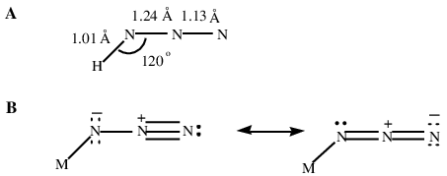
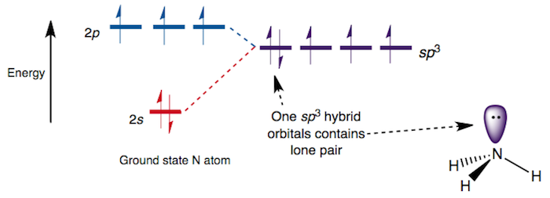
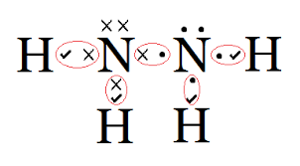
STRUCTURE OF HYDRIDES OF N
AMMONIA NH3
N3H & N2H4

Slide 11
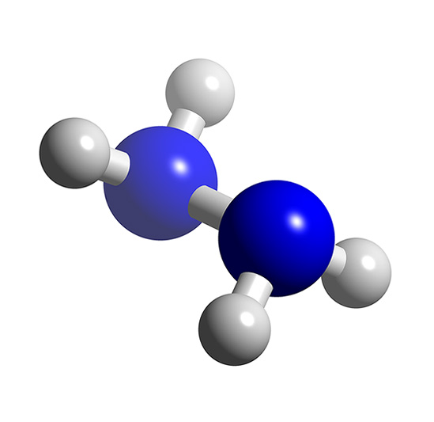
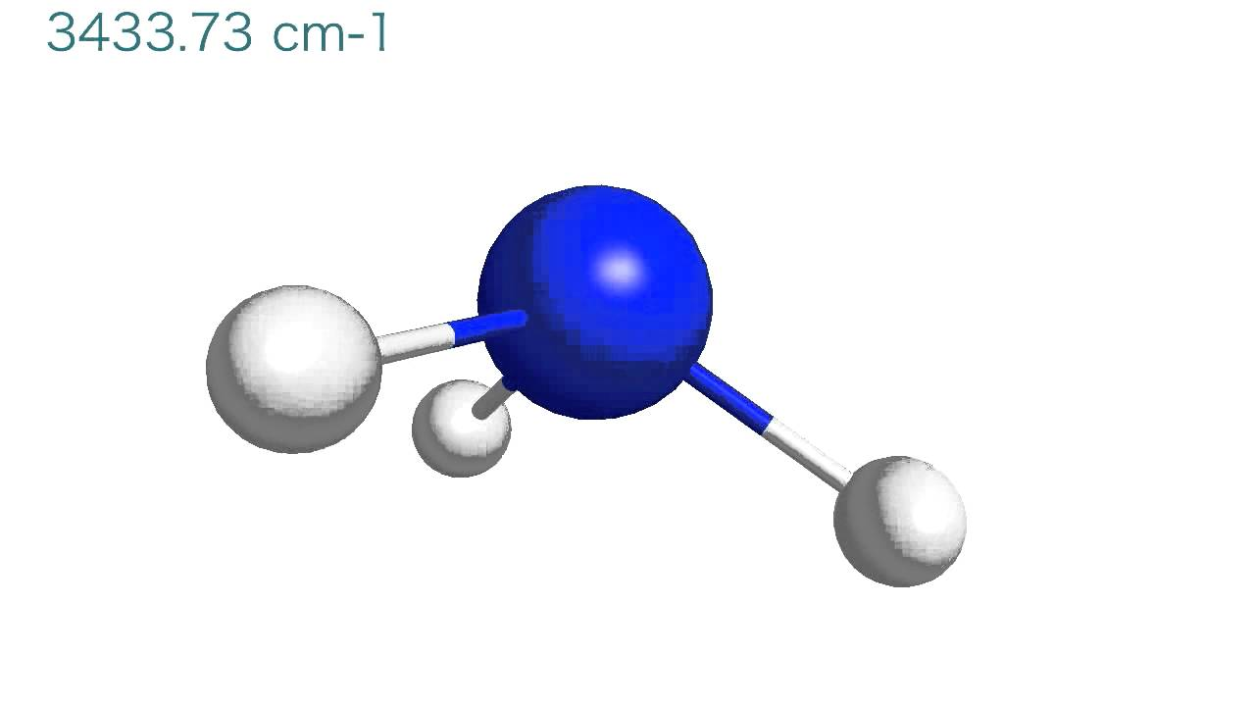
CRYSTAL MODELS
NH3 AMMONIA
N2H4 HYDRAZINE

Slide 12
HYDRIDES OF PHOSPHORUS
There are two hydrides of phosphorus which are important
PH3 PHOSPHINE
P2H4 DIPHOSPHINE

Slide 14
BASIC CHARACTER OF HYDRIDES
In group 15, the hydrides have a lone pair on the central atom. Going down the group, size of the atom increases. And hence, electron density over the group 15 elements decreases. Thus tendency to donate electrons decreases and basicity decreases.
Q Arange hydrides of group 15 in decreasing order of basicity

Slide 15
Phosphine PH3
Preparation:
Hydrolysis of metal phosphides
Na3P + H2O NaOH + PH3
Heating Phosphorous acid
H3PO3 200 c H3PO4 + PH3
In LAB it is prepared by heating white phosphorus with sodium hydroxide
P + NaOH + H2O NaH2PO2 + PH3

Slide 16
Phosphine Properties
It is extremely toxic colourless gas
It is thermally less stable than NH3 and decomposes
PH3 P4 + H2
It catches fire when heated to 150 c
PH3 + O2 H3PO4
It is a weaker base than ammonia
PH3 + HBr PH4Br
It is a strong reducing agent
CuSO4 + PH3 Cu3P2 + H2SO4

Slide 17
Phosphine Properties
It is used in smoke screens
Calcium. phosphide reacts with water which catches fire to give smoke
Amixture of Calcium carbide and calcium phosphide is used in holmes signals for ships because this mixture gives phosphine with sea water and phosphine gas catches fire and lightens acetylene formed from CaC2
Q Which is a stronger Lewis Base NH3 OR PH3 & why
Q The HNH bond angle in NH3 is 107 and in PH3 97
Q Arrange hydrides of group 15 in decreasing order of thermal stability.

Slide 18
Diphosphine P2H4
Preparation: By passing phosphine through an electric discharge at 5-10 Kv
By the action of calcium phosphide on water along with PH3
Properties :
Catches fire immediately in contact with air
Easily oxididised by atm O2
P2O4+O2 P+H2O
It decomposes on standing
P2H4 P4H2 +PH3 +H2

Slide 19
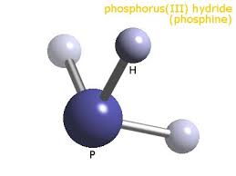
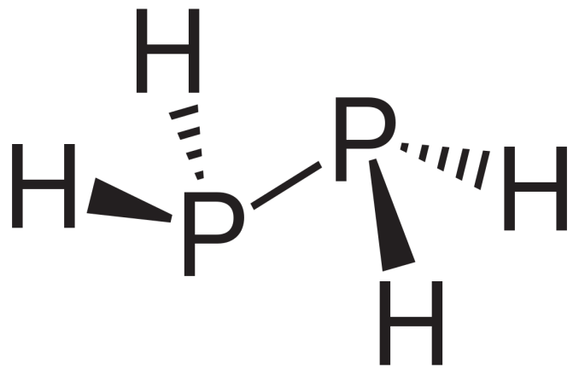
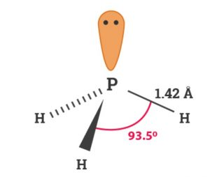
STRUCTURE
PHOSPHINE(Similar to NH3)
DIPHOSPHINE (Similar to N2H4)

Slide 20
Halides of Nitrogen
Nitrogen forms only trihalides out of which NF3 is stable ,NCl3 is explosive and NBr3 and NI3 do not exist as such.
NF3 + H2O No Reaction
NCl3 + H2O NH3 + HOCl
Q NCl3 exists ,NCl5 does not .Explain

Slide 21
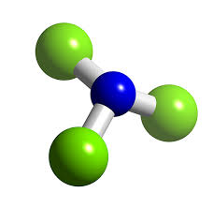
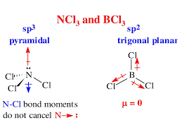
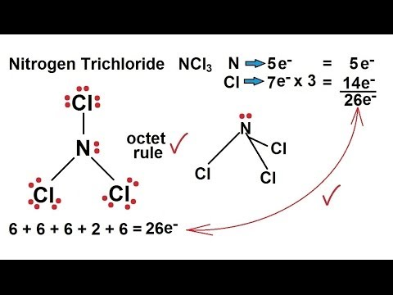
Structure of NCl₃
BCl3 is trigonal planar,NCl3 is pyramidal ?

Slide 22
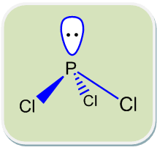
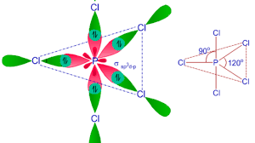
Halides of Phosphorus
Phosphorus trichloride PCl3
Phosphorus pentachloride PCl5
Phosphorus has 3s² 3p³ valence shell configuration and in this vacant d orbitals are available ,so Phosphorus can extend its covalency from +3 to +5,hence two types of halides are formed unlike Nitrogen which forms only trihalides.

Slide 23
PCl3 Phosphorus trichloride
Learn and try to balance the equations
It is prepared by the direct reaction of elements
P4 + Cl2 PCl3
It fumes in moist air
It reacts with Chlorine and sulphuryl chloride to give PCl5
PCl3 + Cl2 PCl5
PCl3 + SO2Cl2 PCl5 + SO2
It is oxidised easily by oxygen and P2O5
PCl3+O2 POCl3
PCl3 + P4O10 + Cl2 POCl3
Used to convert alcohols to alkyl halides and acids to acid chlorides
PCl3 + ROH RCl + H3PO3
PCl3 + RCOOH RCOCl + H3PO3

Slide 24
PCl₅ Phosphorus Pentachloride
  PREPARATION: It is easily prepared from PCl3 and Cl2
  PCl3 + Cl2 CCl4 PCl5
  PROPERTIES:
  It is thermally unstable and dissociates on heating
  PCl5 PCl3 + Cl2
  It undergoes hydrolysis depending on the amount of water used.
  PCl5 + H2O POCl3 + 2HCl
  PCl5 + ⁴H2O H3PO4 + ⁵ HCl
  PCl5 is used to convert –OH GROUP TO Cl and –COOH to -COCl.

Slide 25
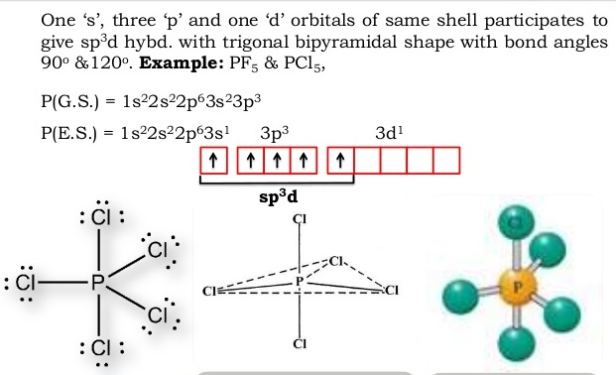
Structure of PCl₅
Phosphorus extends its covalency to +5 and undergoes sp³d hybridisation after excitation .
It forms five sigma bonds with five chlorine atoms and has regular geometry with trigonal bipyramidal shape.

Slide 26
Some questions for practice
What is the difference between white and red phosphorus?
N2 is a gas and P4 is a solid Comment
Arrange hydrides of group 15 in decreasing order of thermal stability
Arrange hydrides of group 15 in increasing order of reducing character.

Slide 27
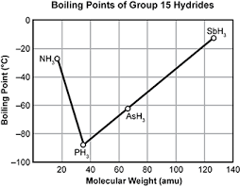
THANX
HOPE YOU CAN WRITE SOME WORDS ON THIS PICTURE

